Slide 1

Together
Alessandro Appolloni
Davide Muserra
Nicola De Siena
Gianmarco Di Felice

Slide 2
Idea
Together is an app whose purpose is to gather people with the same interests and hobbies, in order to socialise with people that are on the same wavelength of yours

Slide 3



Competitors:
Fubles
Allow to organize sports matches
Allow to participate in matches that have been organized by someone else
Only football

Slide 4

Competitors:
Vampr
Communication between musicians, music industry professionals and music fans.
Only music
Not properly an app for activity groups
Doesn’t show all other group participants

Slide 5

Competitors:
Gamer Link
Discover teammates to play with
Only videogames

Slide 6
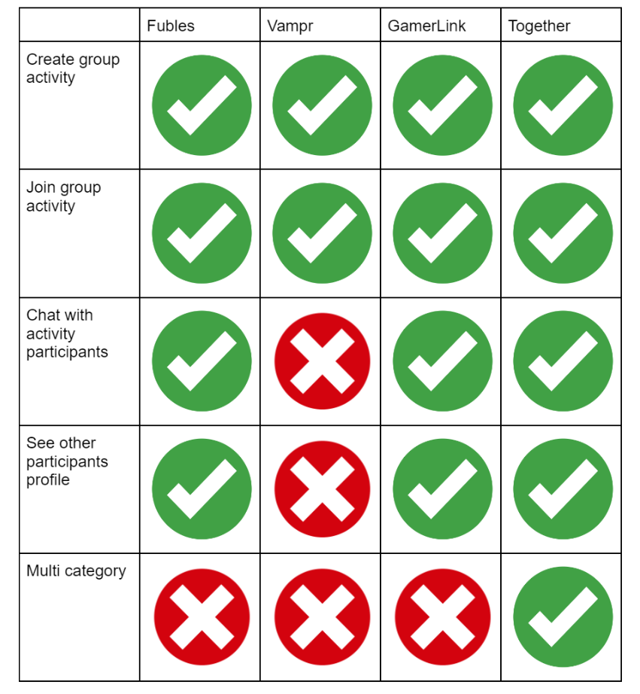
Competitors: general overview

Slide 7
User Profile
Age: 18 - 35 years
Gender: Male, Female
Category: Student
Location: Italy
Technology: Smartphone

Slide 8

Persona
Scenario
It is Monday evening, Anna has finished attending her lessons and she’s tired. She wants to watch the next Paul Thomas Anderson at the Cinema, but this time she would like to go with other people so she asked on social media who is interested in watching it.
Anna is a 24 years old student that lives in Rome and she’s attending a Master Degree in Chemical Engineering at ‘’Università la Sapienza’’.
She is passionate about cinema, so she spends a lot of time watching movies and tv shows. Often in free time she uses her smartphone with 4G mobile internet to share her reviews about movies on social networks and to give some advice to the ones that ask for it. She is also a sunny person, but a little shy therefore has a slight difficulty in meeting new people even though she would like to.

Slide 9

Persona
Scenario
It is Friday evening, Salvatore has finished his homeworks for the week, so he takes the smartphone to contact some of his friends to see if they can organize a Call of duty match. He needs 10 people(Salvatore included) and he realizes that most of his friends are unavailable. So he needs to find 9 more people if he wants to play and a good way to do that is using Together!
Salvatore is 18 years old who lives in Napoli where he has been attending the artistic high school for five years. He is passionate about what he studies, so she spends a lot of time learning from art history books to then put into practice the new concepts. Often in free time he likes to play video games and watching live streams of pro player on twitch.

Slide 10
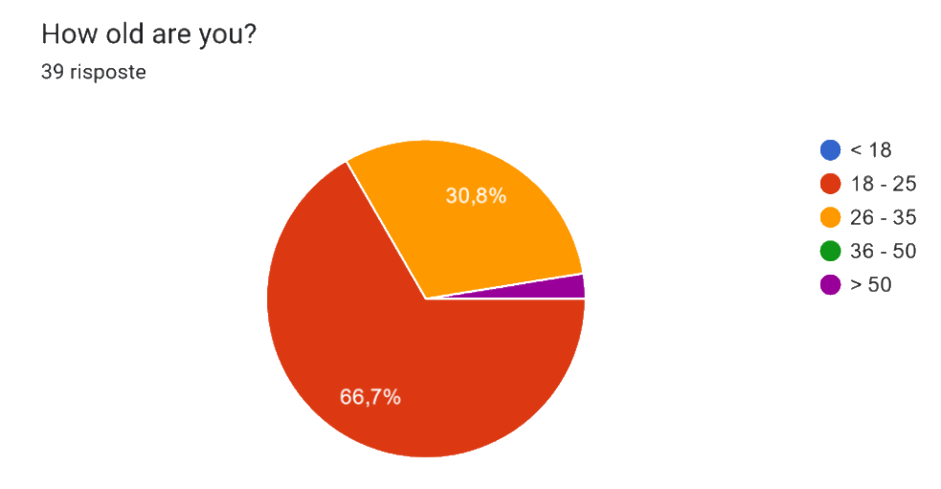
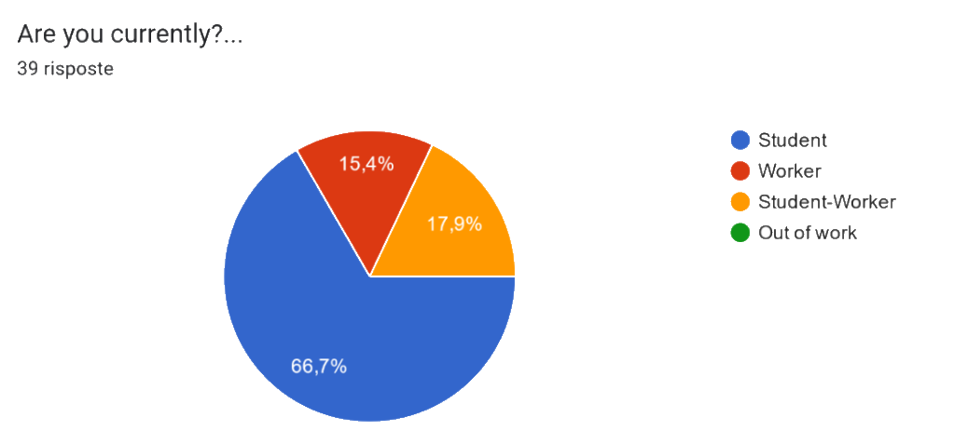
Questionnaire
We reached 40 people and these data were useful to validate our assumptions and ideas and to improve.
We understood that a great amount of people like to play multiplayer video games, sports, music and to go to the cinema. They also prefer to do these activities in groups rather than individually. Regarding the sharing of personal information, we understood that the majority of people doesn’t want to share the telephone number, so we didn’t add this information in the personal profile of the user.

Slide 11
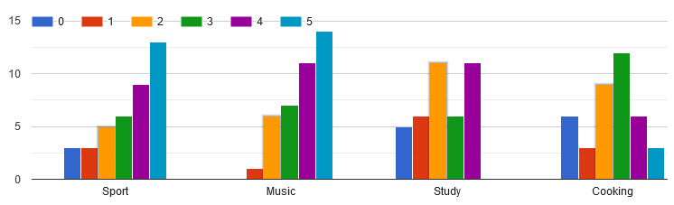
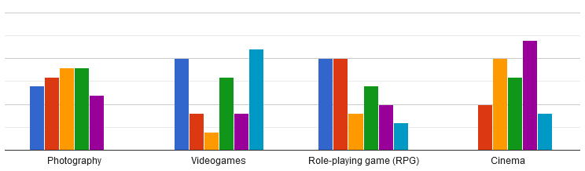
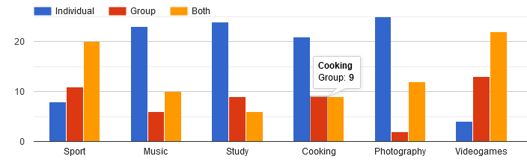
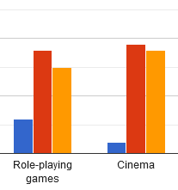
Questionnaire
In a range from 0 to 5, where 0 stands for "Don't like at all" and 5 for "I like it a lot", for each of the following activities, how much do you like them?
For each of the following activities, do you prefer to do an activity as individual or in group?

Slide 12
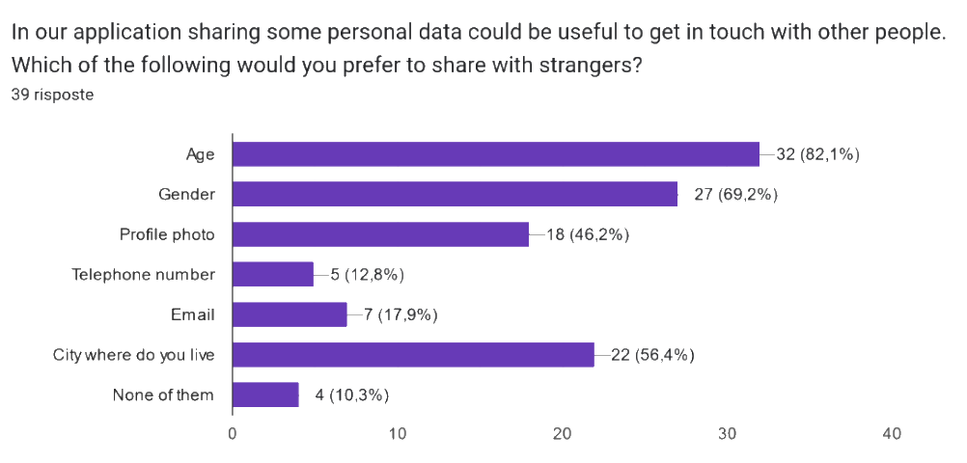
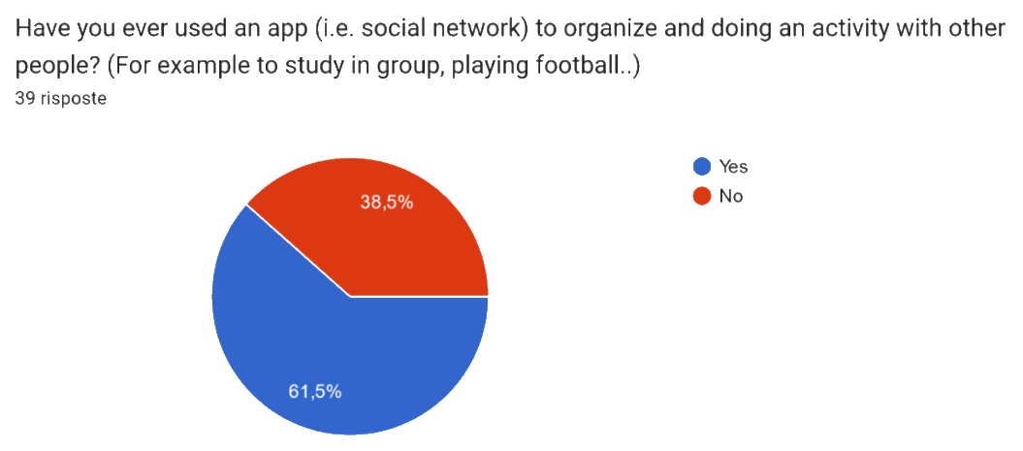
Questionnaire

Slide 13
Questionnaire Conclusions
Age of our customers between 18 and 35
Most of them are students or student-workers
They spend a lot of time on smartphones, so this is the right device on which developing an application
Preferred activities to do in group: video games, sports, music and cinema
No telephone number in the application

Slide 14
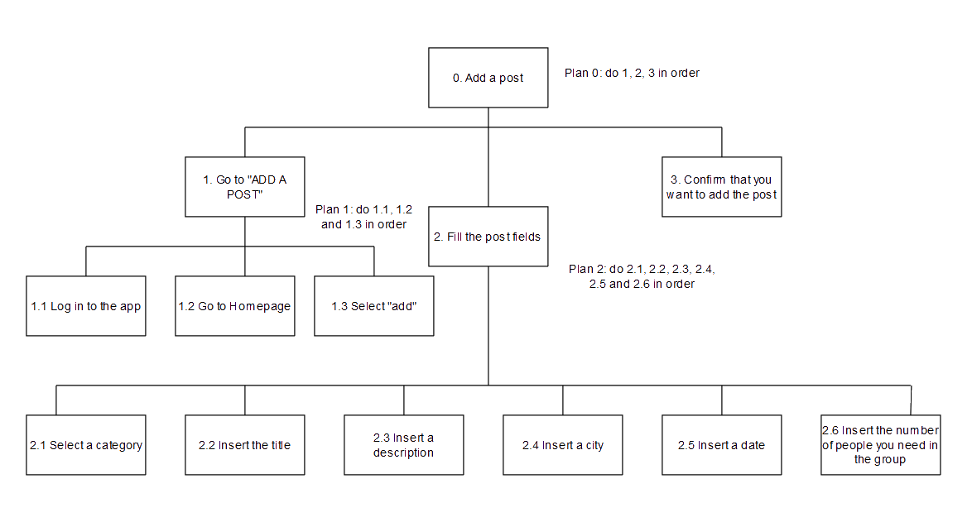
HTA - Add a post (group)

Slide 15
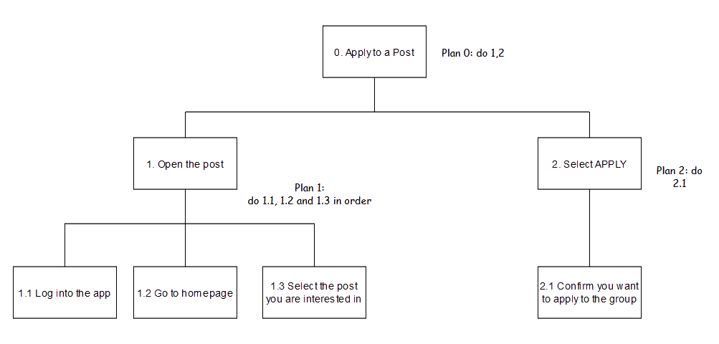
HTA - Apply to a post (group)

Slide 16
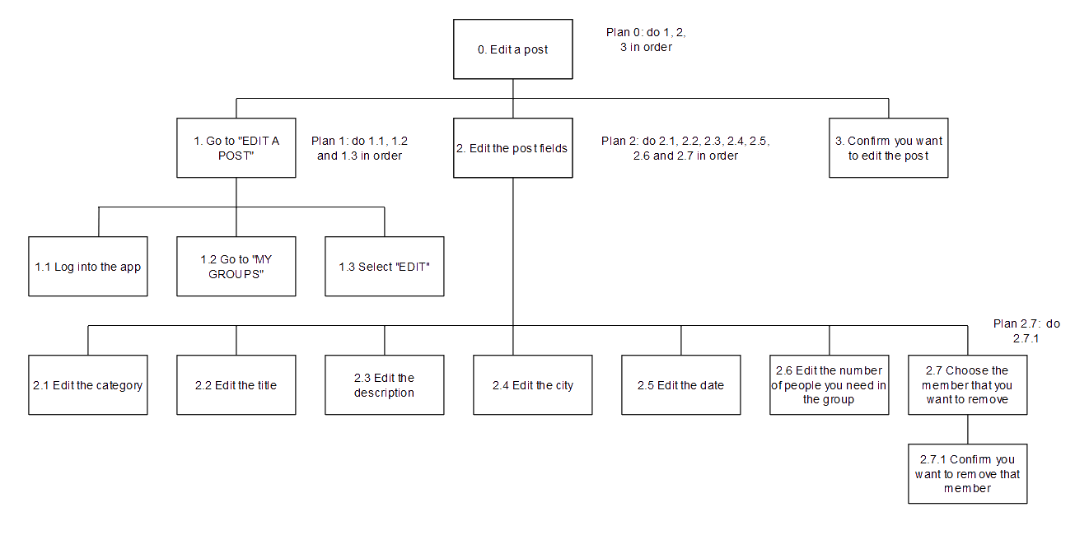
HTA - Edit a post (group)

Slide 17
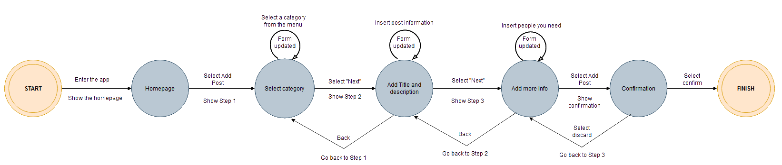
STN - Add a post (group)

Slide 18
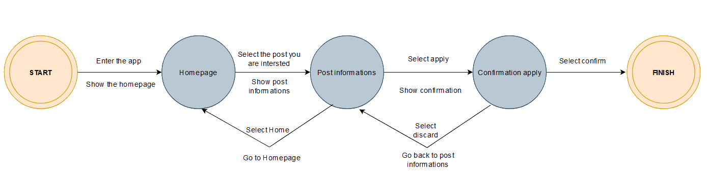
STN - Apply to a Group

Slide 19
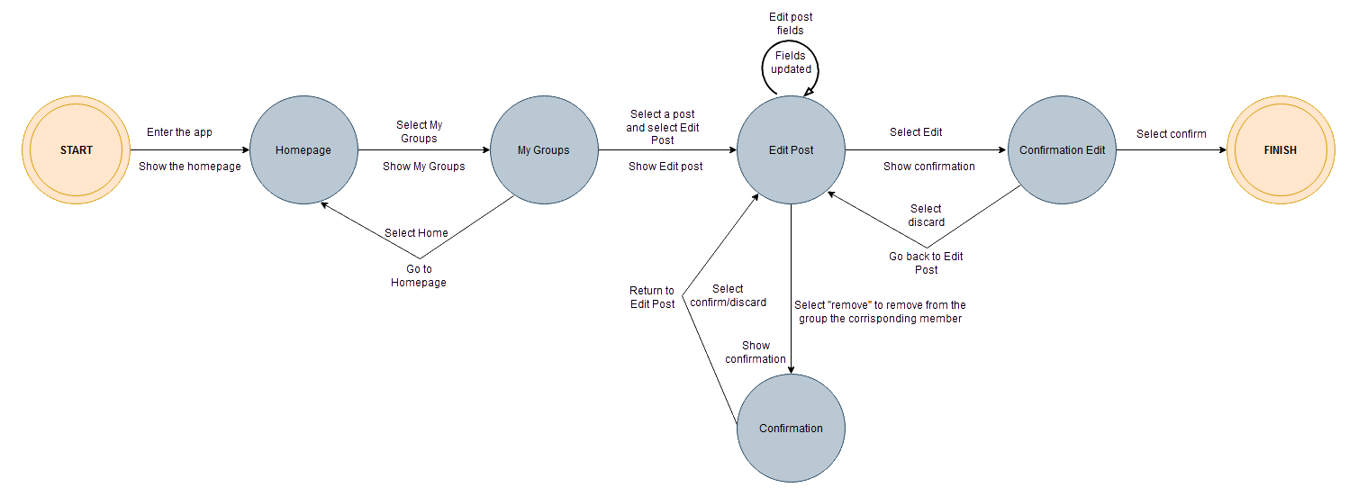
STN - Edit a post (group)

Slide 20
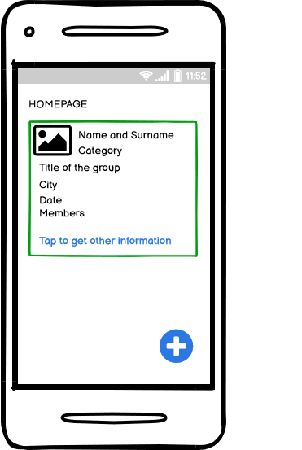
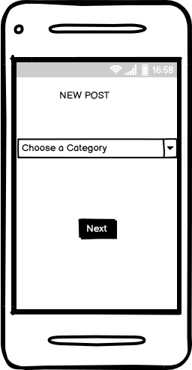
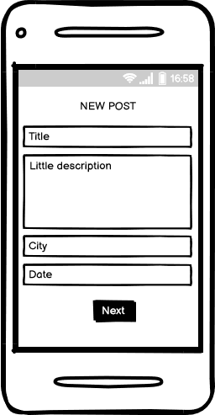
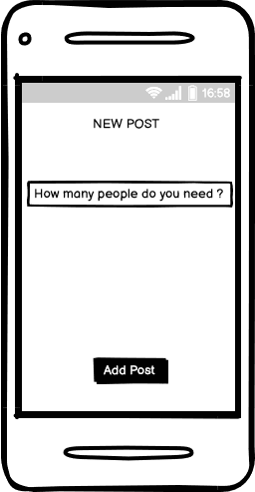
Prototype: Create a new post 1

Slide 21
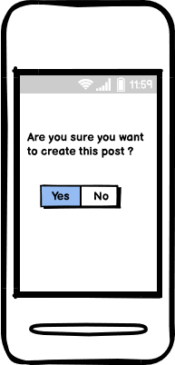
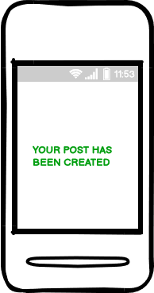
Prototype: Create a new post 2

Slide 22
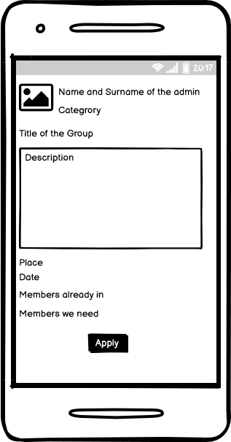
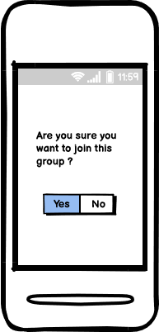
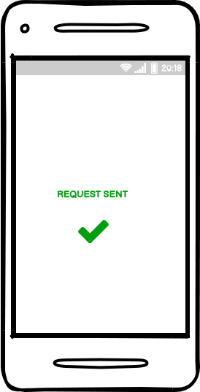
Prototype: Apply to a post (group)

Slide 23
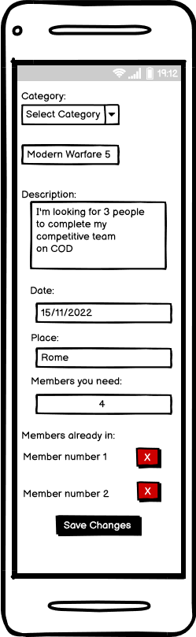
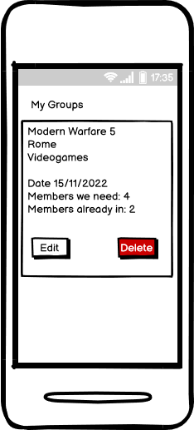

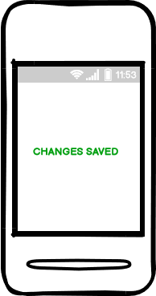
Prototype: Edit post (group)

Slide 24
Expert Based Evaluation - Heuristic Evaluation
Evaluation tests usability and functionality of a system, analyzing both the design and the implementation in order to assess the extent of the functionality of a system, the effect of the interface on user and to identify specific problems.
Heuristic Evaluation debugs the design problems analyzing the usability of the system following the Nielsen’s heuristics, which are usability criteria, and reporting when they are violated and how high is the severity of the violation. This is done testing the interface.
It is Based on Jakob Nielsen’s 10 Usability Heuristics:
1. Visibility of system status
2. Match between the system and the real world
3. User control and freedom
4. Consistency and standards
5. Error prevention
6. Recognition rather than recall
7. Flexibility and efficiency of use
8. Aesthetic and minimalist design
9. Help users recognize, diagnose and recover from errors
10. Help and documentation

Slide 25
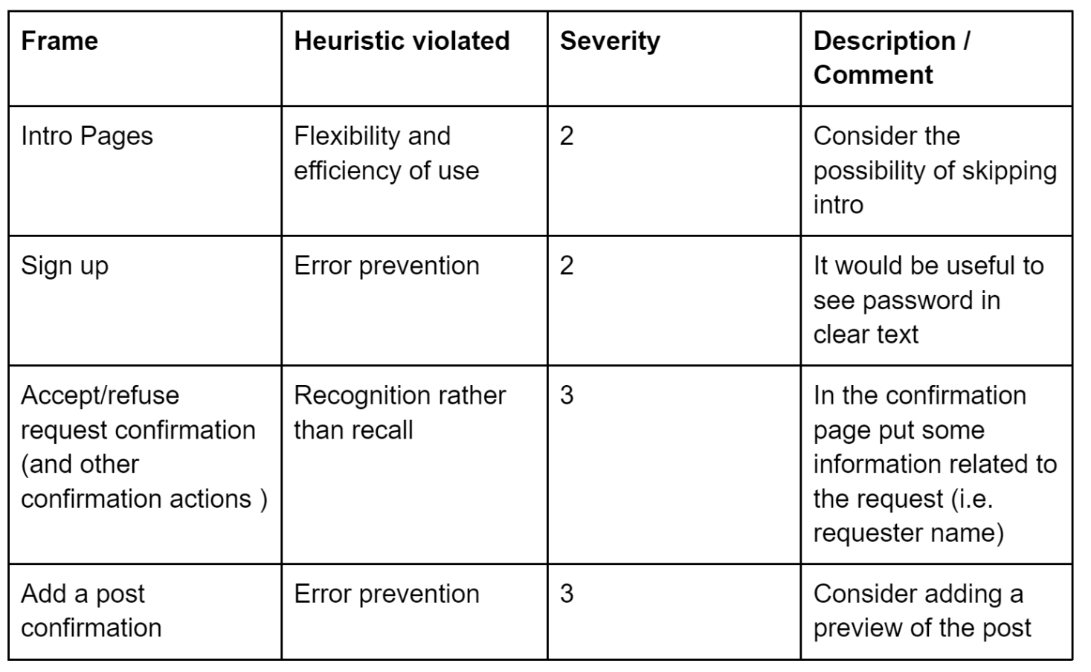
Heuristic Evaluation
Evaluator: Valeria Mirabella
Prototype: Together
Date: 8 october 2022
0 = I don’t agree that this is a usability problem at all
1 = Cosmetic problem only
2 = Minor usability problem
3 = Major usability problem
4 = Usability catastrophe

Slide 26
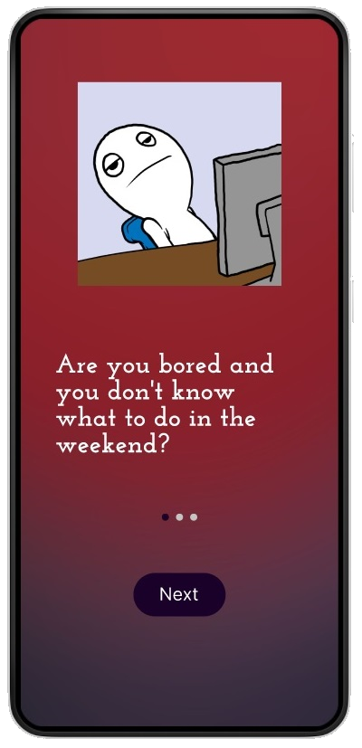
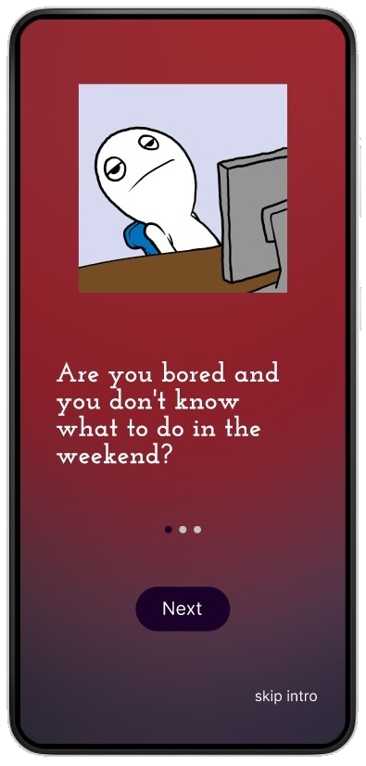
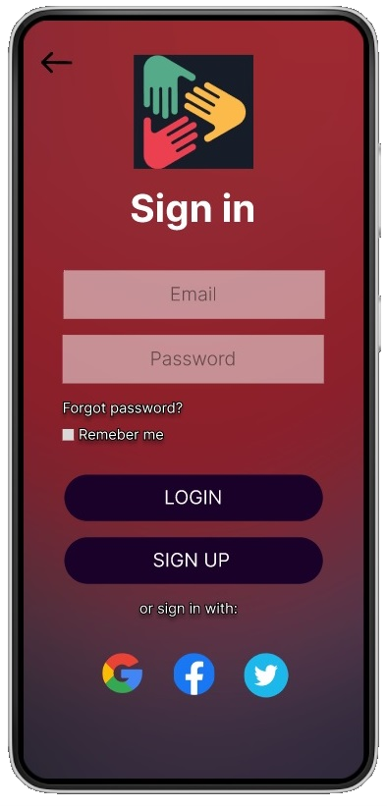
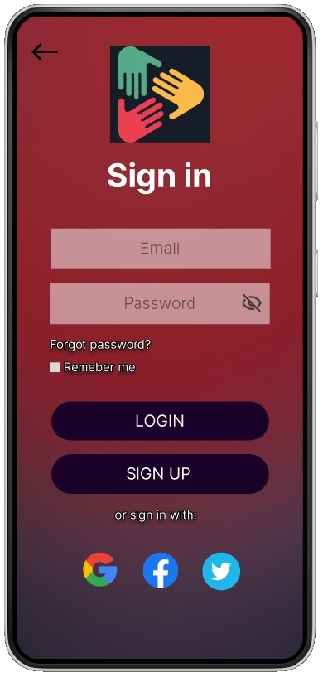
Skip the “intro”
Hide password

Slide 27
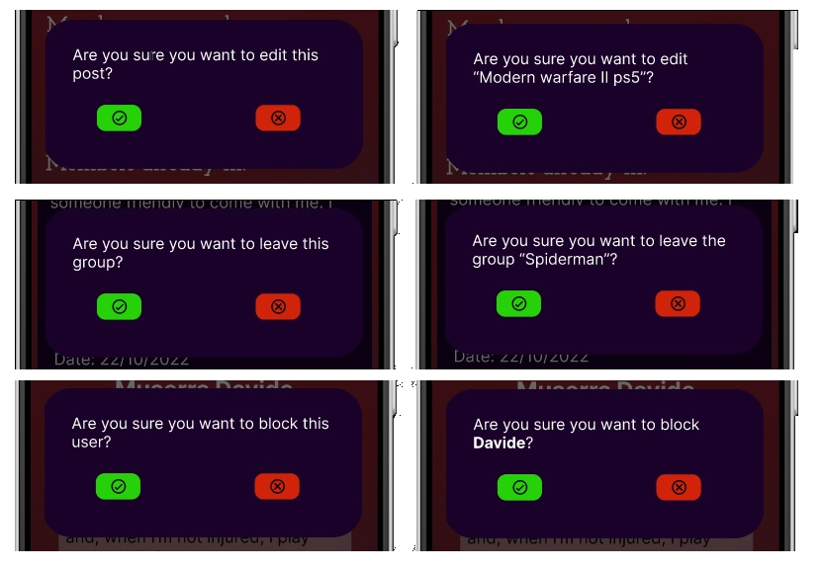
Accept/refuse confirmations

Slide 28
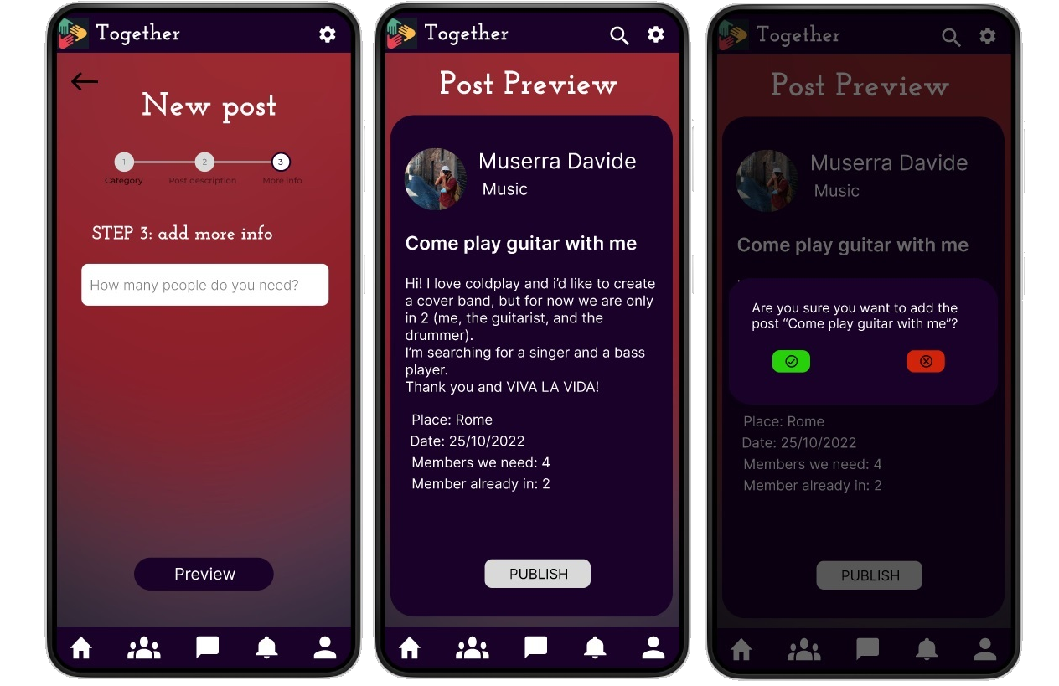
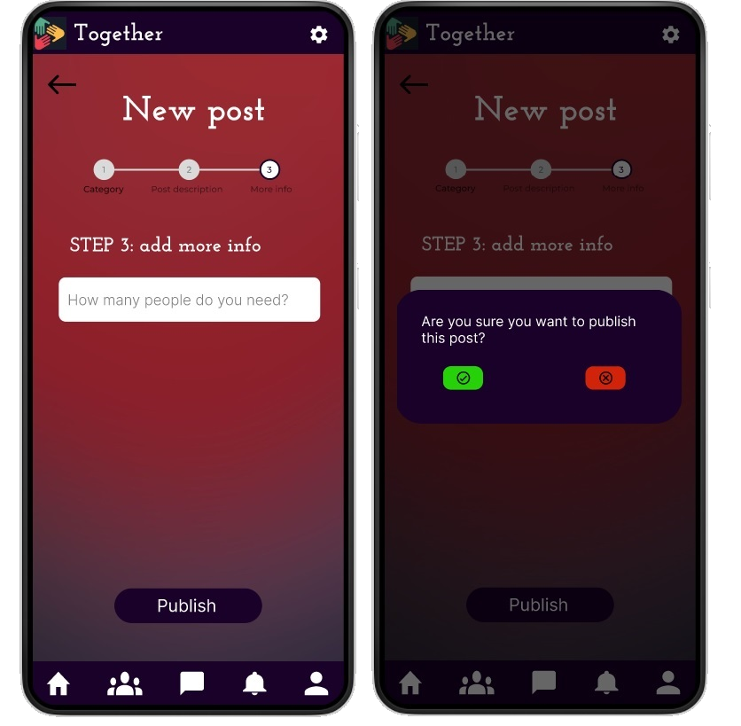
Post preview

Slide 29
User Based Evaluation
The user based evaluation technique used is the “think aloud”. Essentially we asked some users to try the application and see if they understand the features of the application, and how they approach it. This can give us important feedback, from the perspective of a non-expert user which, in fact, will be the real ones who will use the application once it is released.

Slide 30
Think Aloud
We chose a group of 7 people, aged between 24 and 30. Everyone using the app, we asked them to perform two of the main functions: that of requesting to join a group, and that of creating one. We asked them to suppose they already have an account and skip the sign-up process, just to focus on those 2 tasks.
We asked participants what they believe the app is doing, noting their answers and any concerns.
We found that all the users found it really easy to perform those tasks. We found no ambiguity between what they think the app is doing and what the app really is supposed to do.

Slide 31
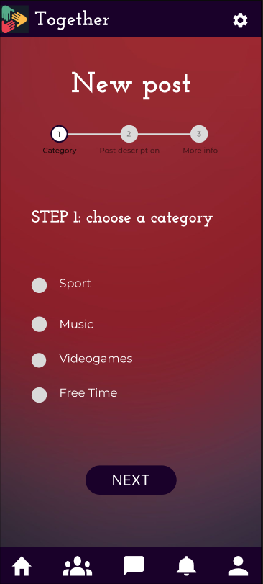
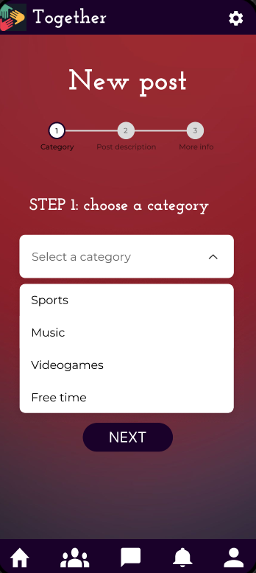
Controlled Experiment
Interface A
Interface B

Slide 32
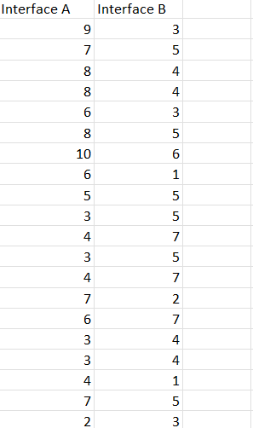
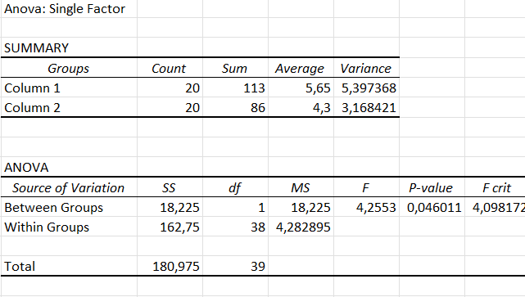
Controlled Experiment

Slide 33
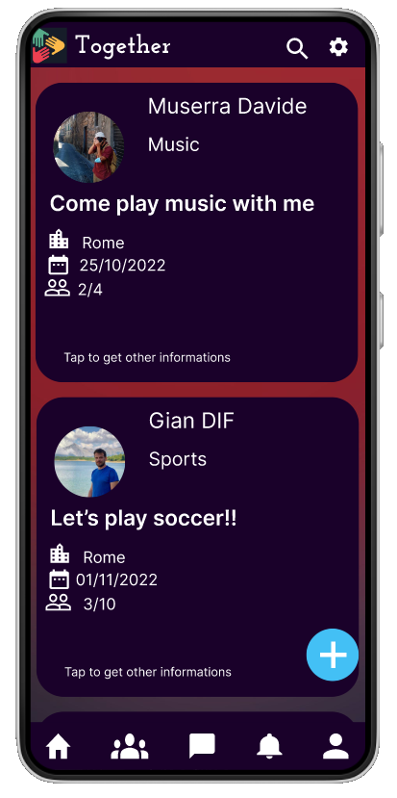
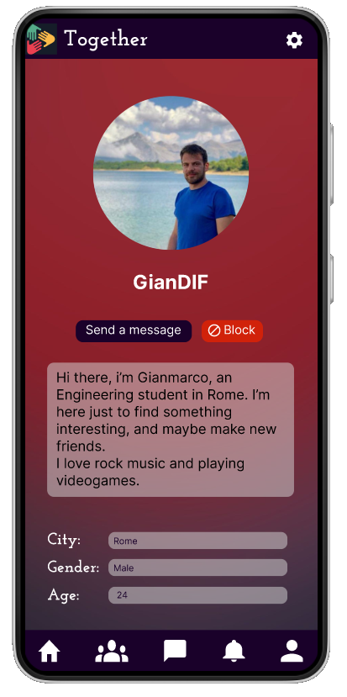
Final Product

Slide 34
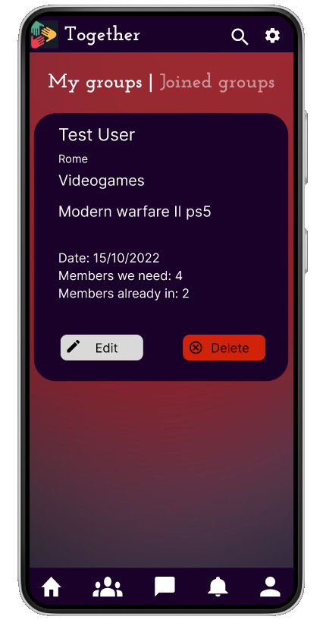
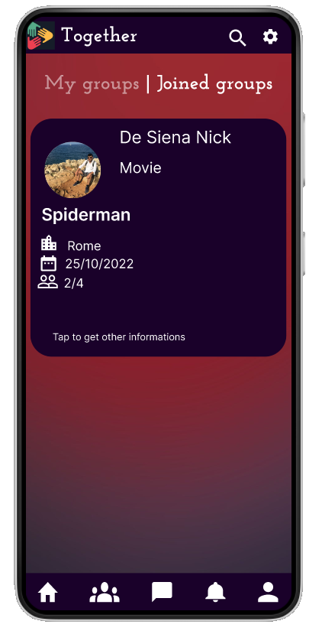
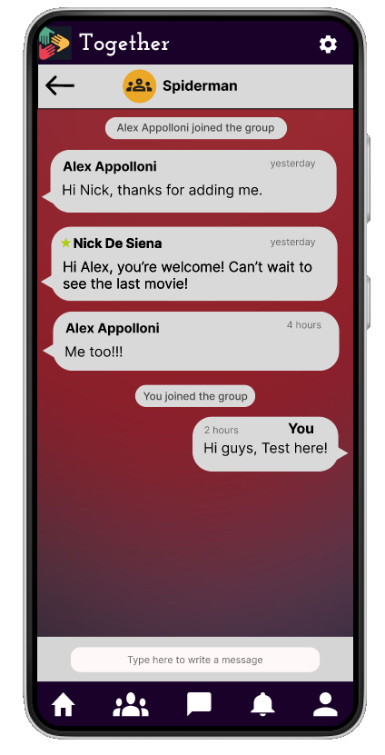
Final Product

Slide 35

Conclusions
This project gave us the opportunity to understand how must be managed the process of creating an application, in order to focus both on the users needs and on the project’s team working.
Now we are working on the implementation of the idea:
https://github.com/nojano/Together.git

Slide 36
Thanks for your attention!

